Slide 1
Real People.
Real Impact.

Slide 2
Mid-Ohio Foodbank
Vision
A hunger-free and healthier community.
Mid-Ohio Foodbank
Mission
To end hunger one nourishing meal at a time and co-create a community where everyone thrives.

Slide 3
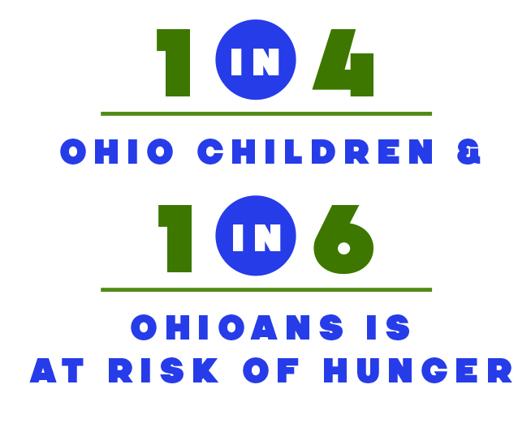
Hunger
can happen to anyone

Slide 5
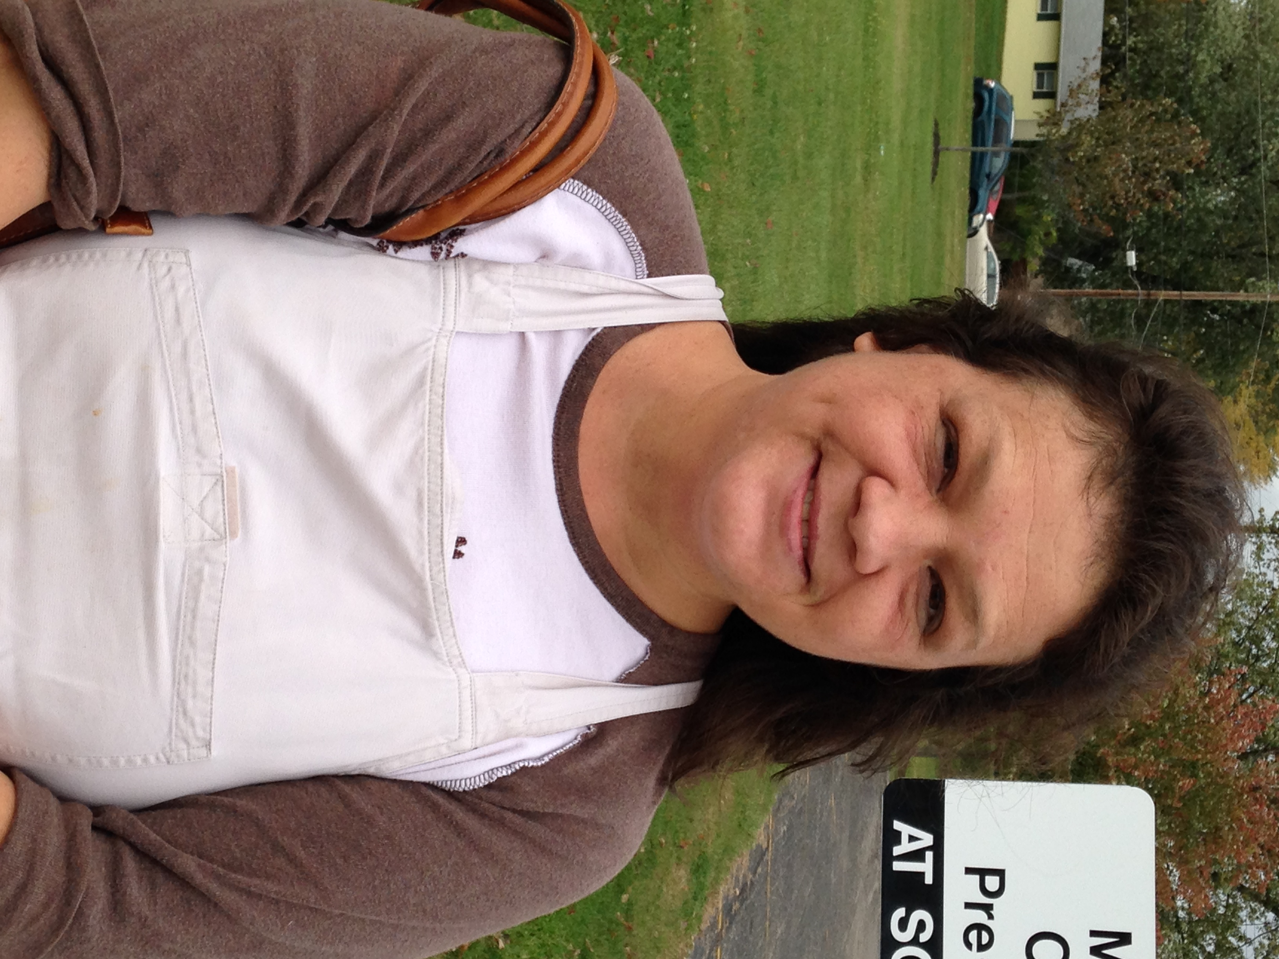
Cynthia’s Story
Health, hope and healing
When Cynthia was diagnosed with cancer, the medicine she was prescribed made her very sick and unable to work. The Mid-Ohio Foodbank Produce Market at her local church offers free fresh fruits and vegetables
for a nutritious diet critical to
maintaining her health.

Slide 6
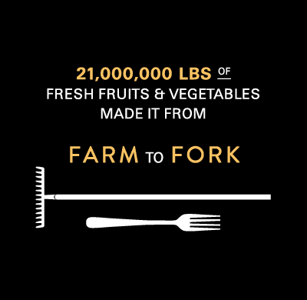
54% of
Mid-Ohio Foodbank’s distribution is fresh foods

Slide 8
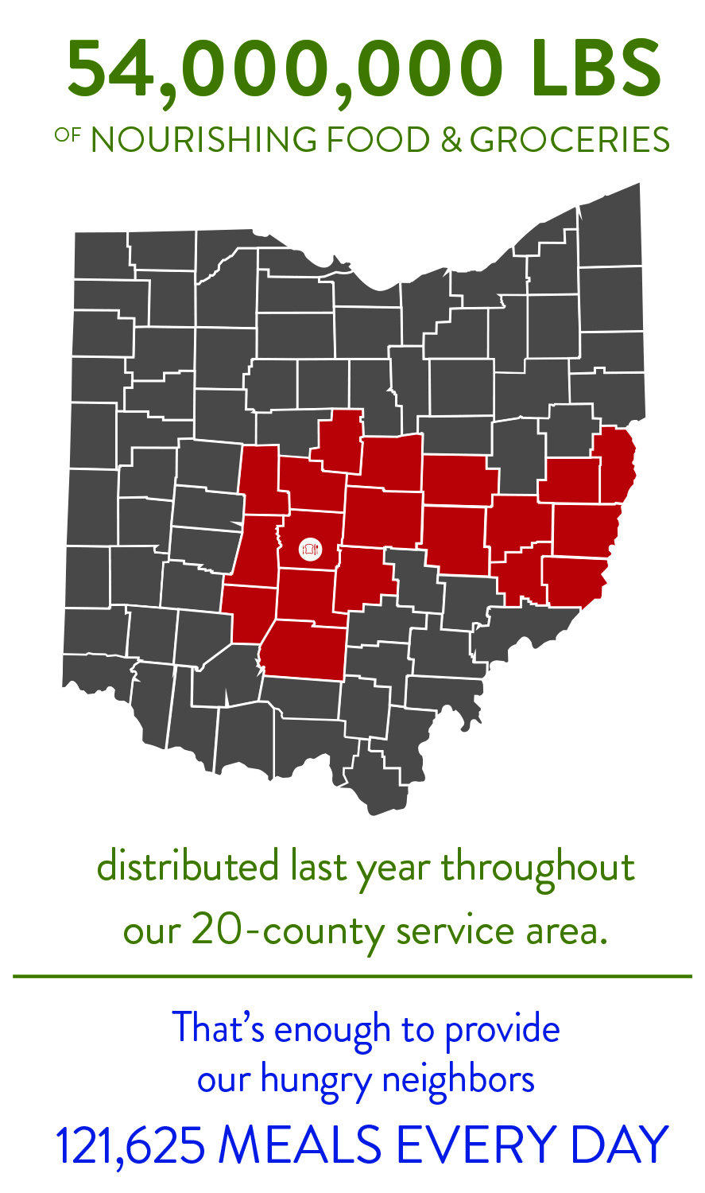

Slide 9
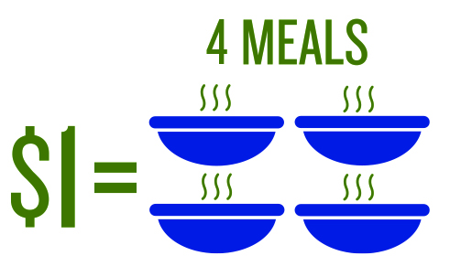
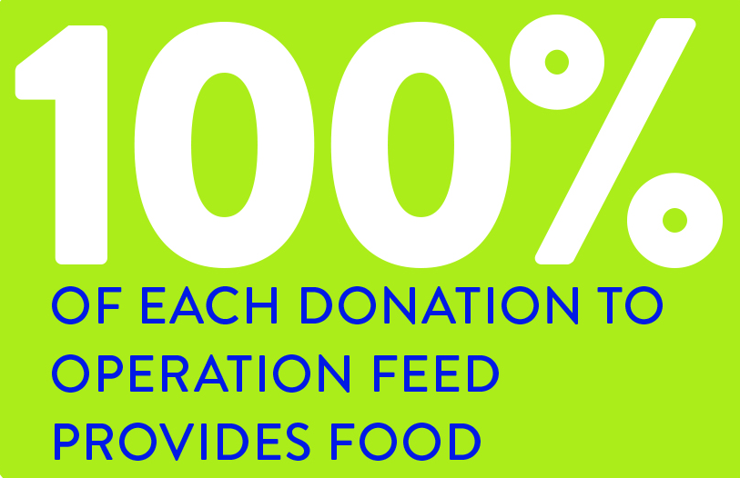
Real Impact.

Slide 10
Join Us.
Real People.
Real Impact.

